Slide 1
Continual Knowledge Infusion into Pre-trained Biomedical Language Models
Kishlay Jha and Aidong Zhang

Slide 2


Continual Learning
t
$X_{1}$ $f_{θ}:X_{1}→Y_{1}$ $Y_{1}$

Slide 3


Continual Learning
t
$f_{θ}=X_{1}∪X_{2}→Y_{1}∪Y_{2}$ $Y_{2}$
$$X_{2}$$

Slide 4
CL Objectives
Data (and tasks) become available only during time.
No access to previously encountered data.
Constant computational and memory resources (efficiency).
Incremental development of ever more complex knowledge and skills (scalability).
Efficiency + Scalability = Sustainability

Slide 5
Catastrophic Forgetting
Catastrophic interference, also known as catastrophic forgetting, is the tendency of an artificial neural networks to completely and abruptly forget previously learned information upon learning new information.
Happens mostly due to Gradient Descent.

Slide 6
Objectives of the Paper
Overall Vocabulary V ={w₁,…,w_{V}} of size V. (Given)
w_{i} is a d-dimensional word embedding that can be derived from any pre-trained language representation model.
Objective: Update the representations for each word w_{i} by infusing semantic knowledge from successive Knowledge Bases (w₁¹, …,w_{V}¹),…, (w₁^{N}, …,w_{V}^{N}) where N refers to the nth Knowledge Base.

Slide 7
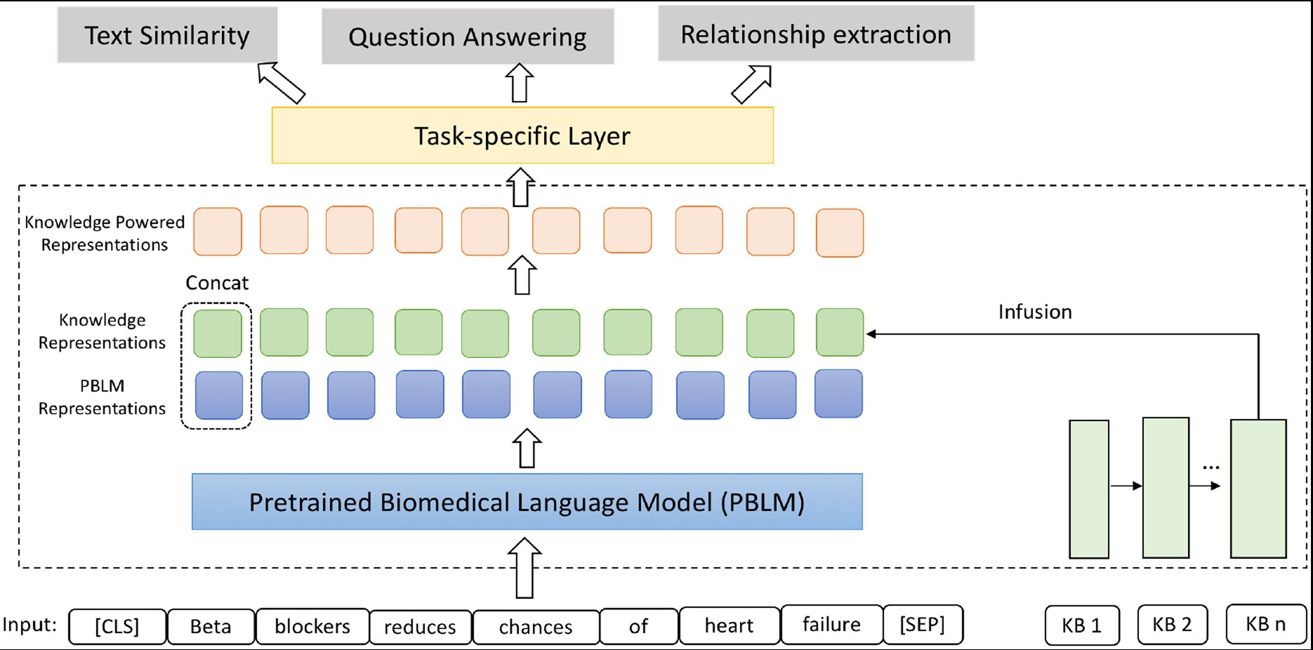
Model Architecture

Slide 8
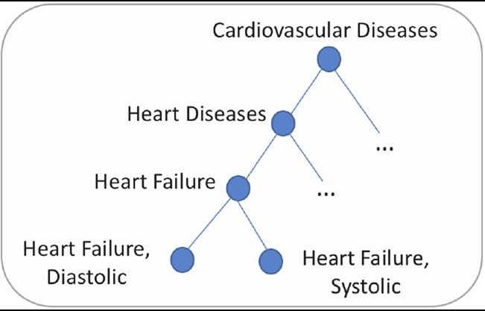



Hierarchical Knowledge Base
Modelling Ancestors: Accumulating features
Coming from higher ancestor to another less deep.
Each concept w_{i} is assigned a basic d dimensional embedding vector e_{i}. Each Concept’s final representation mi is a combination of embeddings of itself and ancestors:
Attention weight is calculated by:
Here f calculates the compatibility between embeddings by a scoring function:

Slide 9


Learning The Attention Weights
Train the model on a multi-label classification task, where objective is to predict the labels for biomedical articles.
Training is done with another single layer perceptron:
Cross-entropy loss as the objective function for the predictive task as follows:

Slide 10


Hierarchical Knowledge Base
Modeling Siblings: widening the semantic distance
between the embeddings of concepts at the same level
Siblings possess both the common and distinctive semantics with respect to one another.
While modeling the ancestors accounts for the semantic commonality between siblings, their specific semantic differences remain ignored.
Modeling the discriminative semantics between siblings can assist in capturing the semantic richness.
The training objective to minimize is the following:

Slide 11
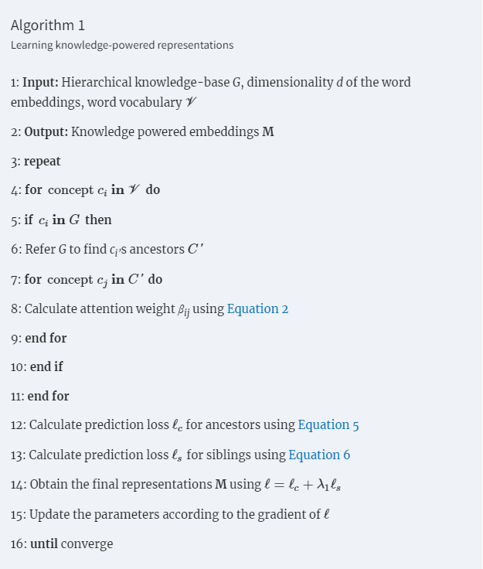
Overall Objective Function and Algorithm

Slide 12
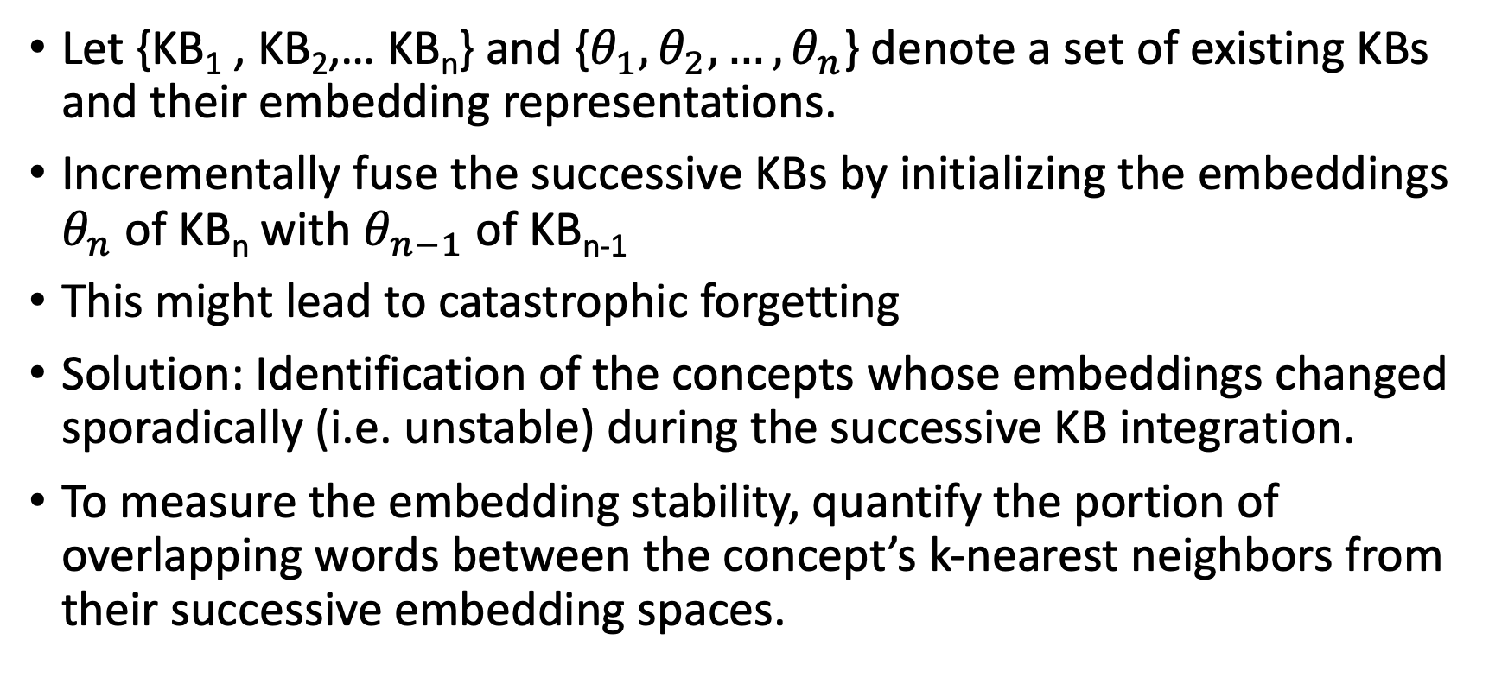
Continual Knowledge Infusion
Let {KB₁ , KB₂,… KB_{n}} and {$θ_{1},θ_{2},…,θ_{n}$} denote a set of existing KBs and their embedding representations.
Incrementally fuse the successive KBs by initializing the embeddings $θ_{n}$ of KB_{n} with $θ_{n−1}$ of KB_{n-1}
This might lead to catastrophic forgetting
Solution: Identification of the concepts whose embeddings changed sporadically (i.e. unstable) during the successive KB integration.
To measure the embedding stability, quantify the portion of overlapping words between the concept’s k-nearest neighbors from their successive embedding spaces.

Slide 13

Continual Knowledge Infusion
Given a concept w_{i}, let c₁ and c₂ be the k-nearest neighbors of w_{i} in the consecutive embedding spaces KB_{n−1} and KB_{n}. The stability value for concept w_{i} is the ratio of overlapping words in c₁ and c₂. All concepts with the stability value below a pre-defined threshold are deemed as unstable
Minimization of variance of representations in the embedding space
Specifically, given two neighborhood sets c₁ and c₂ for a concept w_{i}, the difference of representations in the successive embedding space can be defined by the L2 norm

Slide 14

Continual Knowledge Infusion
Let B (⁠B⊆V⁠) denote the set of concepts that have significantly distorted representations in the successive embedding spaces
Minimize the variance in their representations using the hinge loss:
X∈R^{d×d} is a transformation matrix and γ>0 is a hyper-parameter that denotes the margin. The operator [x]₊ denotes max(x,0)⁠
To enlarge the semantic distance with unrelated neighbors, we generate the negative samples (c₁,c^{ˆ}₂) by substituting c₂ with a random neighbor set c^{ˆ}₂⁠
Orthogonal regularization on X is done to prevent the information loss

Slide 15

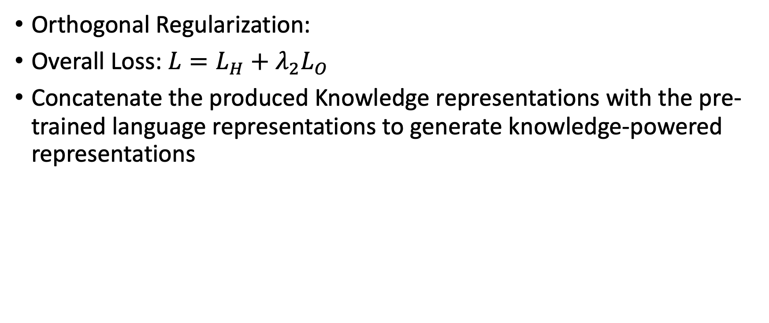
Continual Knowledge Infusion
Orthogonal Regularization:
Overall Loss: $L=L_{H}+λ_{2}L_{O}$
Concatenate the produced Knowledge representations with the pre-trained language representations to generate knowledge-powered representations

Slide 16
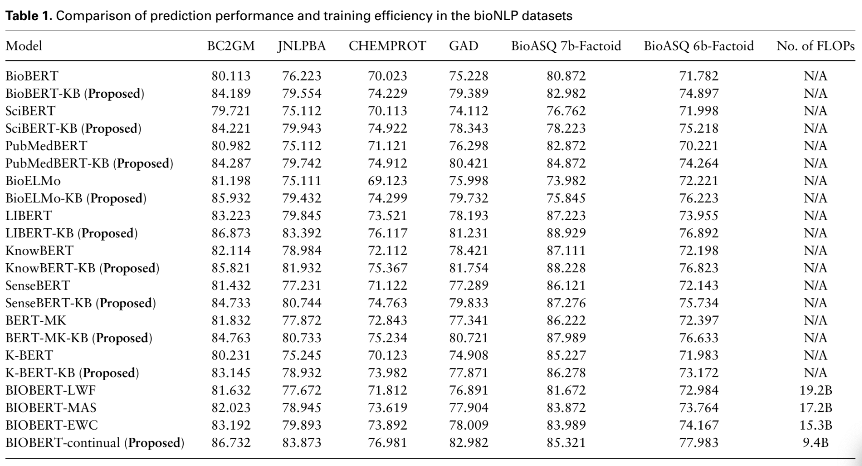
Results of Experiments
Incorporation of prior knowledge is useful for concepts with paucity of co-occurrence of information in the training corpus.

